Slide 1

Company founded in Auckland by Woolf Fisher and Maurice Paykel to import Crosley refrigerators, Maytag washing machines and Pilot mantle radios.
1934

Slide 2
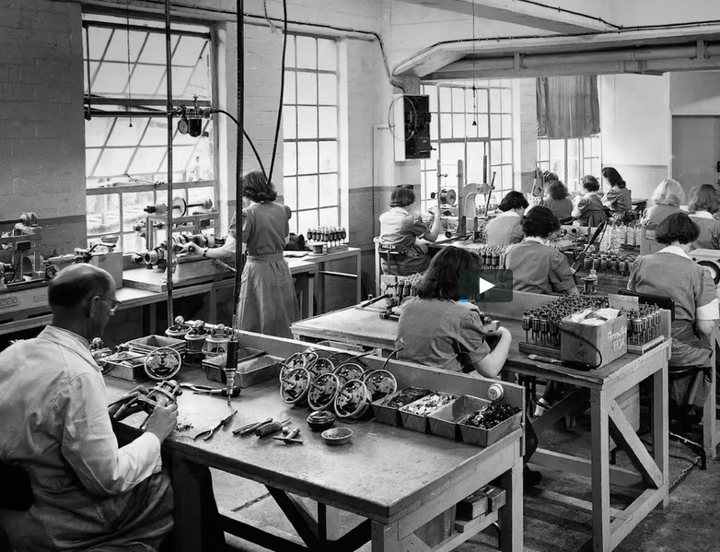
1938 1939
Sales agreement signed
with Kelvinator Corporation, Detroit
Manufacture of refrigerators and wringer washing machines.

Slide 3
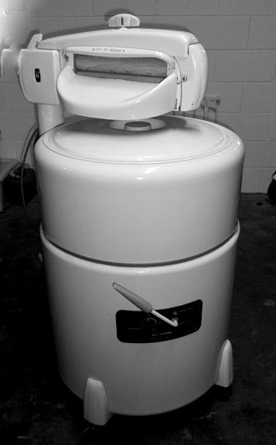
1953
Installation of first washing machine conveyer line.

Slide 4
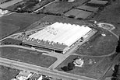
1955
First stage of Mt Wellington plant starts production of refrigeration and laundry products.

Slide 5
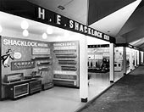
1956
Manufacture of rotary clothes dryers designed and patented by company. Formed association with HE Shacklock, Dunedin.

Slide 6
1957 Allied Industries Ltd established to manufacture Murphy radios and radiograms and later (1960) television receivers. This was the forerunner of Fisher & Paykel Electronics.
1958 Fisher & Paykel open a London office.
1965 Agreement signed with Matsushita Electric for sole distributorship in New Zealand.

Slide 7
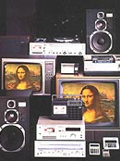
1969 Allied Industries began manufacturing television tubes.
1970 First respiratory humidifier sold.
1971 Agreement with Matsushita Electric for marketing and eventual manufacture of National Panasonic products. Manufacture of respiratory humidifier(the beginnings of Healthcare).

Slide 8
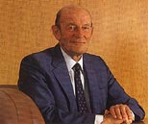
1972 East Tamaki refrigerator manufacturing plant opens.
1974 One millionth refrigerator and one millionth laundry unit produced. Allied Industries build new factory in Mangere.
1975 Sir Woolf Fisher dies. Maurice Paykel appointed chairman and managing director.

Slide 9
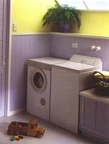
1982 Fisher & Paykel Medical established in United States. Twentieth anniversary of association with Matsushita Electric. Applied Technology (Healthcare) transferred to National Allied at Carbine Road.
1984 Fiftieth anniversary. Prince Philip Design Award refrigerators launched. MR500 Medical Humidifier finalist for Prince Philip Design Award. Takes 50% interest in Isothermal Systems Inc
1985 Launch of Gentle Annie, world's first use of a brushless DC motor in a washing machine.
1986 Official opening of range and dishwasher division's new building at Taieri, Dunedin.

Slide 10
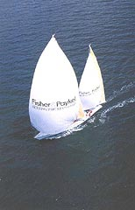
1987 Launch of Fisher & Paykel Appliance brand in Australia. Equiticorp acquires major shareholding (23% at $5 per share). Acquired Australian medical distribution company Medcor, now Fisher & Paykel Healthcare Pty Ltd. Created Fisher & Paykel Electronics Ltd, formerly Allied Products Division.
1988 Launch of Fisher & Paykel New Zealand maxi yacht entrant in the 1989/90 Whitbread Round the World Race.

Slide 11

1992-1993 International sales increase by 54% to exceed $200m for first time. Whiteware sales in Australia exceed 150,000 units. Launch of Fisher & Paykel brand in the European market at Domo-technica Appliance Trade Fair, Cologne, Germany.
1994 Fisher & Paykel exports to over eighty countries. Healthcare international sales remain at over
1995 90% of Healthcare turnover. Whiteware sales in New Zealand increase to 260,000 units.
1998 DishDrawer, the unique double drawer dishwasher launched.
2000 Record group profit of $54.4m, exceeds $50m for the first time. International revenue of $551.4m exceeds 70% of total trading revenue. Healthcare revenue grows by 20.8% to exceed $140m for the first time.

Slide 12
2001-2002 Fisher & Paykel Healthcare Corporation Ltd and Fisher & Paykel Appliances Holdings Ltd become 2 separately listed companies in November 2001.

Slide 13
In 2004, Fisher & Paykel Appliances purchased the United States-based cookware manufacturer Dynamic Cooking Systems, and Italian cookware company Elba in 2006.

Slide 14
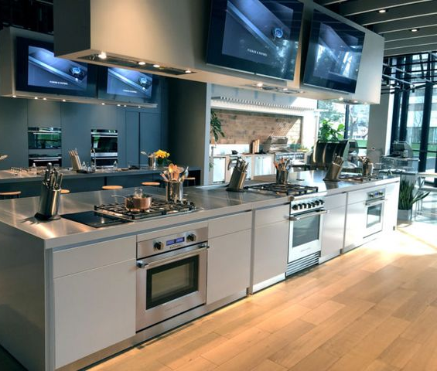
In 2011, Fisher & Paykel launched the first of a series of events that embraced the concept of the Social Kitchen.

Slide 15
In June 2006, the Italian cookware business Elba was acquired from DeLonghi for €78 million (NZ$158 million). Elba has been since renamed as Fisher & Paykel Appliances Italy and exports to over 54 countries, focusing on the UK market.

Slide 16
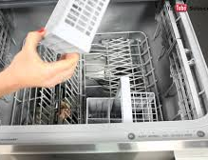
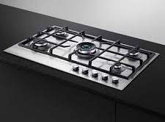
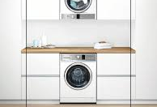
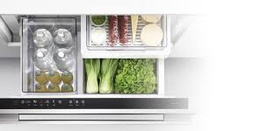
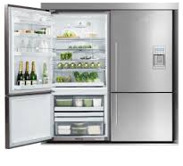
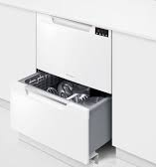
Fisher & Paykel makes a relatively broad range of mid to high end dishwashers. Its notable drawcard to the Fisher & Paykel brand is the Dish Drawer range. Most dishwasher brands don’t offer drawer-style dishwashers, so Fisher & Paykel is the leader for this niche design. In 2018, Australian customers gave Fisher & Paykel 4 out of 5 stars for overall customer satisfaction for dishwashers.

